Slide 1


Capstone Project
Hotel Booking EDA Analysis
Kaveri Shende
Arshad Aafaq D
Sakshi Chaturvedi
Vikas Kumar
Yogesh Agre

Slide 2


Content:
Problem Statement
Why Hotel Booking Analysis and it’s data
Data Summary
Exploring our database
Flow chart and EDA Process
Cleaning of Data and Manupulation
Data Manupulations
Data Visualization
Challenges faced during data exploration
Conclusions of our analysis

Slide 3

Problem Statements:
Our Agenda is to Analysis of various datasets that covariates governing the bookings of hotels.
Hotel booking datasets has enormous potential to drive hotel booking business to success. Analysis of different insights can be drawn for Hotel owners to work on and capture the market growth.
Our main objective is to perform EDA on the given dataset to discover key factors responsible for Hotel booking system and their success.
We need to analyze the data and come up with meaningful insights that would actually help business to strategize their moves.
Hotel Booking Dataset
Data Summary
Cleaning of Dataset
Analysis & Visualization

Slide 4
Hotel Booking Analysis and it’s data?
The purpose of our project was to gather and analyze detailed information about hotels in order to provide insights and estimate the profit.
The majority of Revenue Management research on demand forecasting and prediction issues is conducted in the tourism and travel-related industries.
We have given two hotel data sets. i.e., the resort hotel is one of the hotels, and the city hotel is the other. There are 32 columns and 119390 rows.
With out industry-specific data, it is impossible to completely understand the requirements and peculiarities of the remaining tourism and travel sectors, such as hospitality, cruising, theme parks, etc. To help overcome this restriction, two hotel datasets with demand data are given.
Hotels will be able to identify the issue that is causing customers to cancel their bookings, as well as the reason for the cancellations, by utilizing the predictive
It would be fantastic if the hotel management team could identify the root cause and develop a better strategy.
The goal of our project was to collect and analyze detailed hotel information in order to provide insights and estimate profit.

Slide 5
Data Summary
Analysis of the dataset over a span of Three years - 2015, 2016 and 2017
hotel
is_canceled
lead_time
arrival_date_year
arrival_date_month
arrival_date_week_number
arrival_date_day_of_month
stays_in_weekend_nights
stays_in_week_nights
adults
children
babies
meal
country
market_segment
distribution_channel
is_repeated_guest
previous_cancellations
previous_bookings_not_canceled
reserved_room_type
assigned_room_type
booking_changes
deposit_type
agent
company
days_in_waiting_list
customer_type
adr
required_car_parking_spaces
total_of_special_requests
reservation_status
reservation_status_date

Slide 6

Exploring our Database
In Hotel booking Dataset it contain basic information about two types of hotel i.e city hotel and resort hotels. We have given 32 rows and 119390 columns. The features of play store are:-
hotel : Hotel type.
is_canceled : value indicates if the booking is canceled or not.
lead_time : How long in advance the booking was made.
arrival_date_year : Customer arrival year.
arrival_date_month : In which month of the year customer visited hotel.
arrival_date_week_number : In which week of the year customer arrived.
arrival_date_day_of_month : Date of the month customer visited hotel.
stays_in_weekend_nights : Customer stayed or booked to stay in hotel during weekend nights.
stays_in_week_nights : Customer stayed in hotel during week nights.
adults : Number of adults
children : number of children.

Slide 7
Exploring our Database Continued..
babies : Number of babies.
meal : Type of meal booked.:
country : Country of orgin of cutomer.
market_segment : where the bookings came from.
distribution_channel : Booking distribution channel. The term “TA” means “Travel Agents” and “TO” means “Tour Operators” .
is_repeated_guest : Value indicating if the booking name was from a repeated guest (1) or not (0).
previous_cancellations : Number of previous bookings that were cancelled by the customer prior to the current booking.
previous_bookings_not_canceled : umber of previous bookings that were cancelled by the customer prior to the current booking.
reserved_room_type : Code of room type reserved. Code is presented instead of designation for anonymity reasons.
assigned_room_type : Code for the type of room assigned to the booking. Sometimes the assigned room type differs from the reserved room type due.
booking_changes : Number of changes/amendments made to the booking from the moment the booking was entered on the PMS.

Slide 8
Exploring our Database Continued..
agent : ID of the travel agency that made the booking.
company : ID of the company/entity that made the booking or responsible for paying the booking.
days_in_waiting_list : Number of days the booking was in the waiting list before it was confirmed to the customer.
customer_type : Type of booking, assuming one of four categories.
adr : Average Daily Rate as defined by dividing the sum of all lodging transactions by the total number of staying nights.
required_car_parking_spaces : Number of car parking spaces required by the customer.
total_of_special_requests : Number of special requests made by the customer (e.g. twin bed or high floor).
reservation_status : Reservation last status, assuming one of three categories: Canceled – booking was canceled by the customer; Check-Out: customer check out from hotel,No show: Customer did not check-in hotel and informed hotel with reason.
reservation_status_date : Date at which the last status was set. This variable can be used in conjunction with the ReservationStatus to understand when was the booking cancelled or when did the customer checked out of the

Slide 9
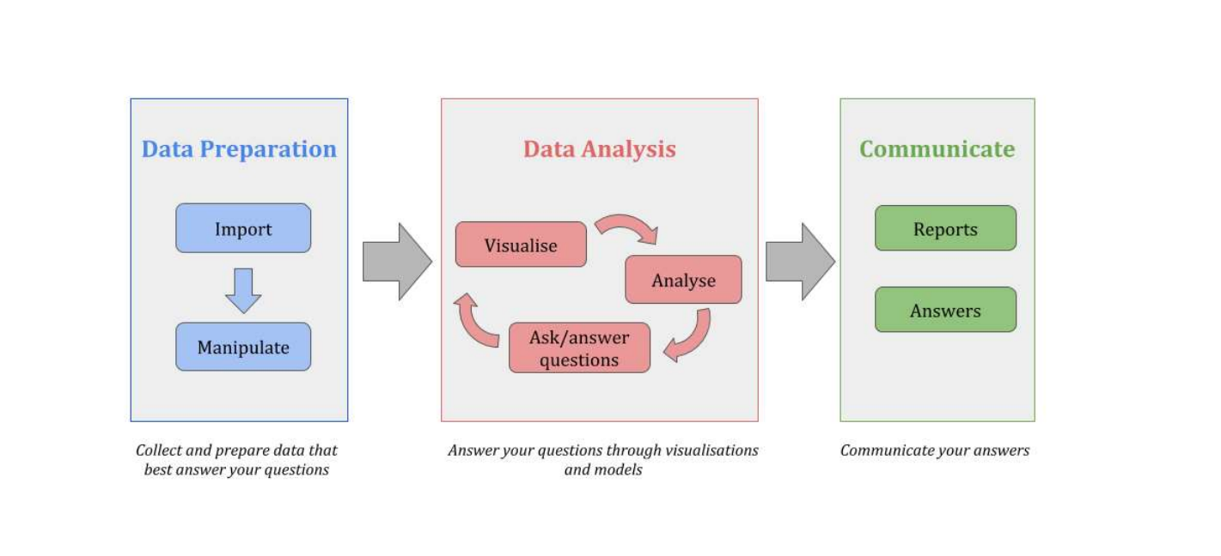
Flowchart and EDA Process

Slide 10
Cleaning of Data and Manupulation
Company and agent values replaced with zero
02
03
04
01
.
Dropped duplicate rows from the dataset
Converting datatype of columns 'children', 'company' and'agent' from float to int
changing datatype of column 'reservation_status_date' to data_type.

Slide 11
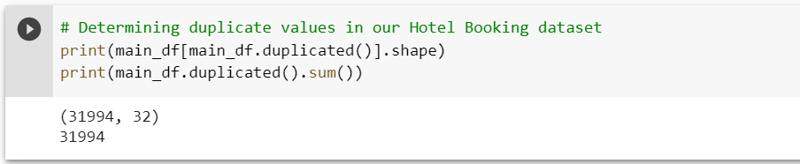

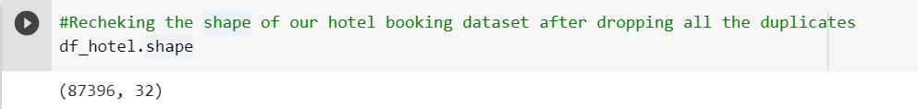

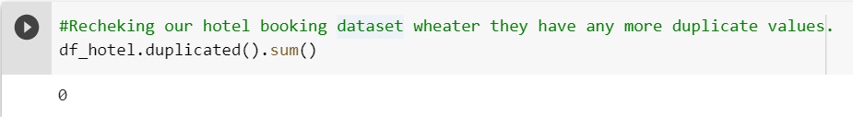
Removing Duplicates

Slide 12
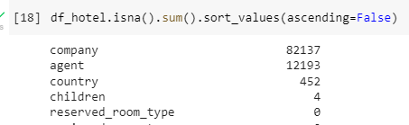
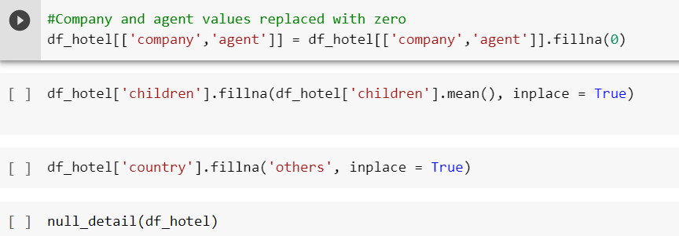
Dealing with null values of play store
There are 4 columns Children, Agent, Company, Country with Null values
Company and agent values is replaced with Zero, country is replaced with others

Slide 13
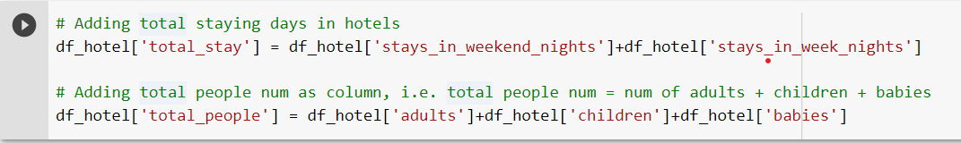
Converting Datatypes
Adding Required Columns

Slide 14
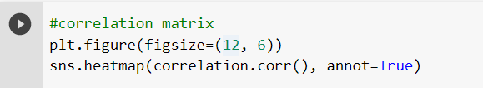
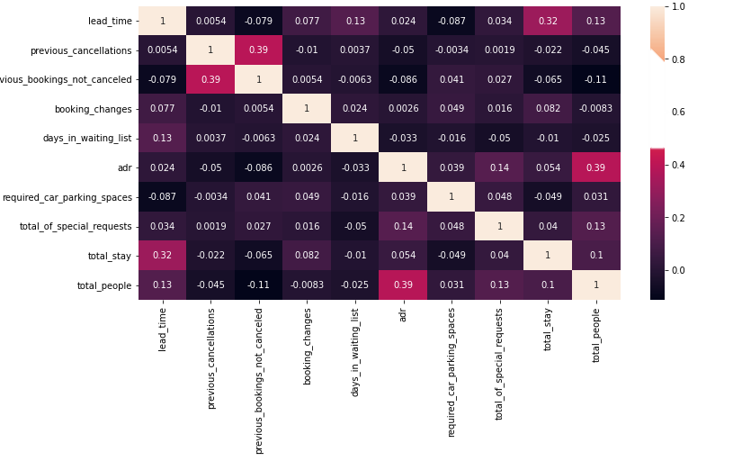

Data Visualization
The total length of stay and the lead time have a slight correlation. This could imply that for longer hotel stays, people generally plan little ahead of time.
Ad revenue is slightly correlated with total people, which makes sense because more people means more revenue, and thus more ad revenue.

Slide 15
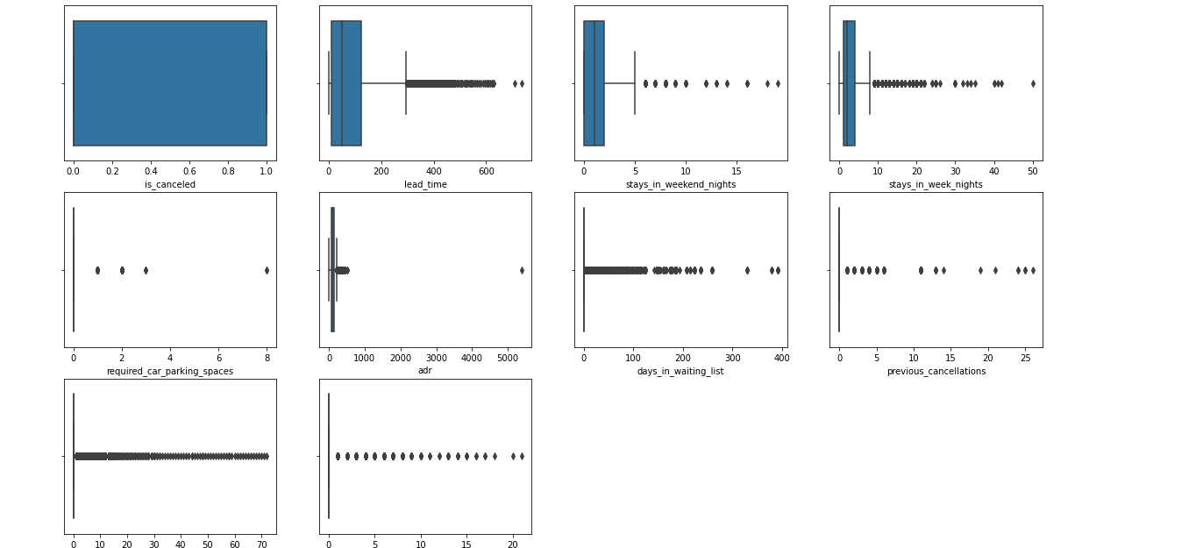
Datavisualization
As we can see, this dataset contains a large number of outliers, implying that it is not very reliable.

Slide 16
Data Visualization Lets take some insights which we have pulled from our analysis
1 what is the count of each type of Hotels ?
2 In which month maximum hotel were booked ?
3 What is the booking rate according to the population?
4 Which form of distribution do customers prefer most?
5 Which hotel will have long-term guests?
6 Which type of food is preferred by the guest?
7 Which hotel has a higher rate of returning customers?
8 which type of hotel is mostly preferred by adults , children or babies
9 Which hotel will have long-term guests?
10 Which hotel produces maximum revenue?

Slide 17
11 Which distribution route has given adr the most boost in terms of revenue?
12 Which room type has highest adr?
13 ADR across different market segment?
14 ADR across the different month.
15 Which month saw the most canceled reservations?
16 Which hotel has the highest cancellation rate, the city or the resort?
17 determining which countries have the most hotel cancellations in different type of hotels
18 Does longer waiting period causes booking cancellation?
19 What is the percentage distribution of required_car_parking_spaces?
20 Which type of food is preffered by the guest?

Slide 18
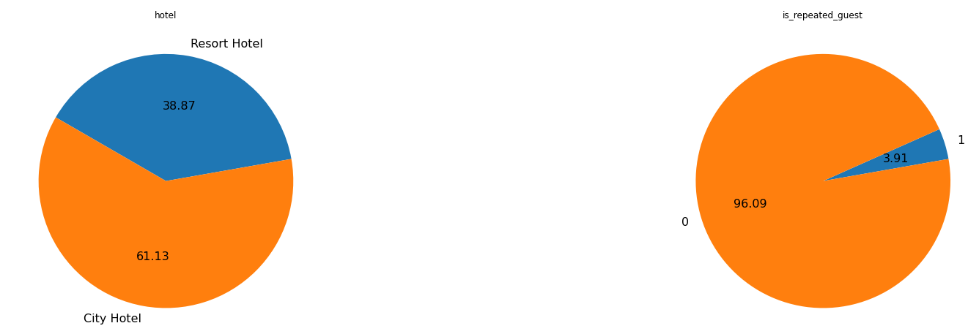
Data Visualization
Which type of Hotel is mostly preferred by the customer ? No of repeated guests?
Resorts hotels were the preferred choice between city and resorts by the customer with 61.13 % booking. It could be attribute to good customer facility.
New Guests are more as 3.91% guests were repeated.

Slide 19
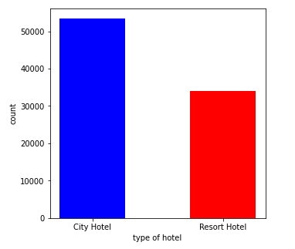

Data Visualization
What is the count of each type of Hotels ?
From the above, we learned that people are booking city hotels more than resort hotels. Now we will find out in which month the people book the hotel.

Slide 20
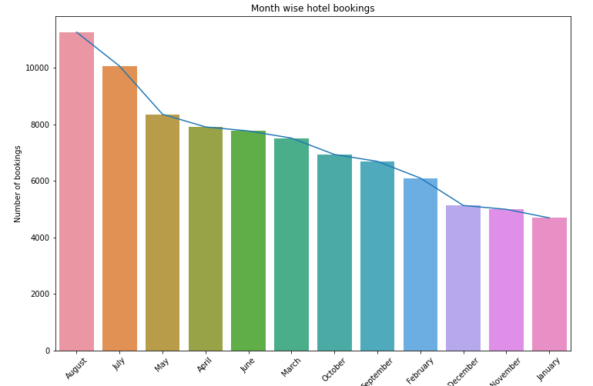
Data Visualization
Which of the two hotels is preferred by customers, and in which month most hotels were booked?
As a result of this , we learned that city hotels were in high demand, with bookings peaking in August.

Slide 21
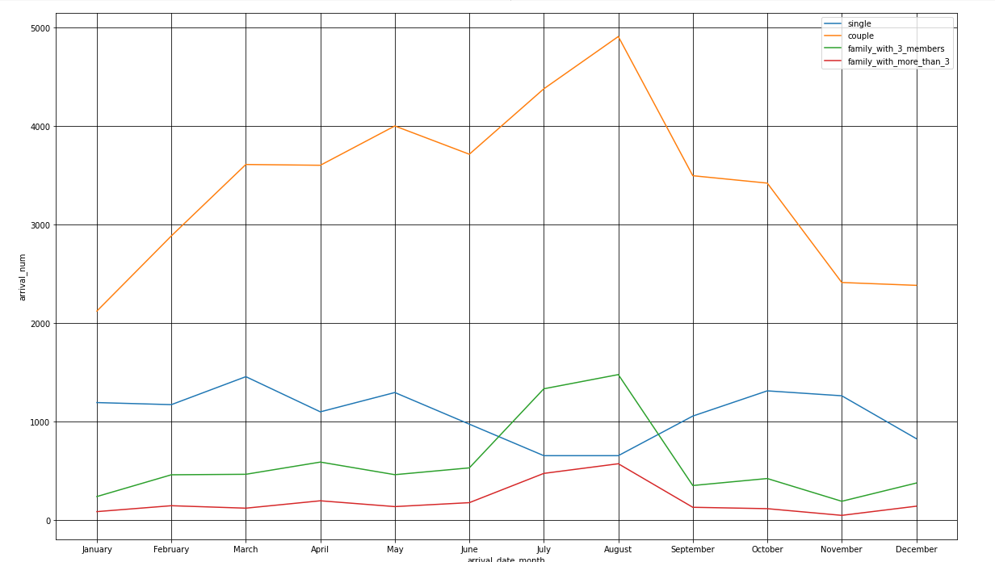
Data Visualization
What is the booking rate according to the population?
It appears that couples made the majority of reservations.
The month of August saw the greatest number of reservations.
Bookings for hotels increased in the months of June, July, and August.
Bookings for families with three or more members are the least expensive.

Slide 22
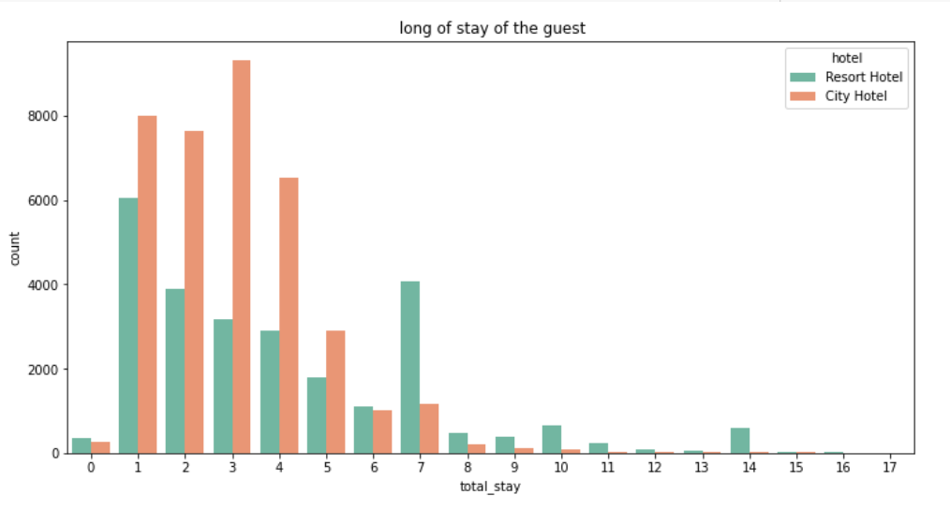
Data Visualization
Which hotel will have long-term guests?
Most visitors of resort hotel stayed for one day, however most city hotel guests spent anywhere between one and seven days.

Slide 23
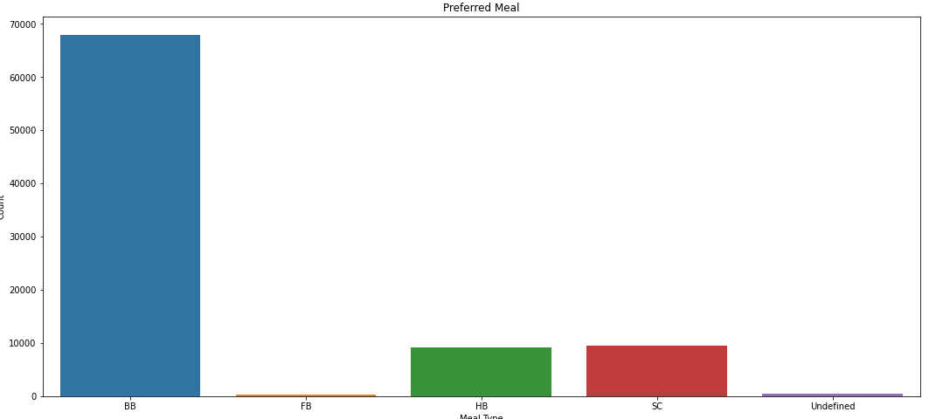

Data Visualization
Which type of food is preferred by the guest?
Meal types in hotels:
BB - (Bed and Breakfast)
HB- (Half Board)
SC- (Supplemental Committee)
FB- (Full Board) (Self Catering)
As a result, the most popular meal type among guests is BB (Bed and Breakfast), followed by HB (Half Board) and SC (Self Catering).

Slide 24
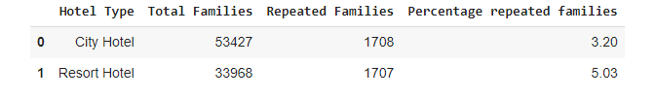
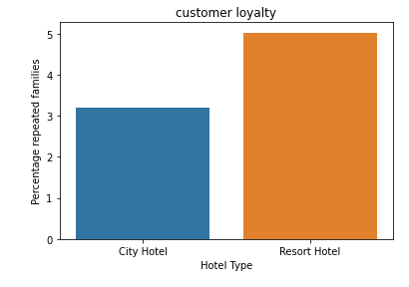
Data Visualization
Which hotel has a higher rate of returning customers?
From the above graph it is clear that highest rate of returning customers are from the resort hotel.

Slide 25
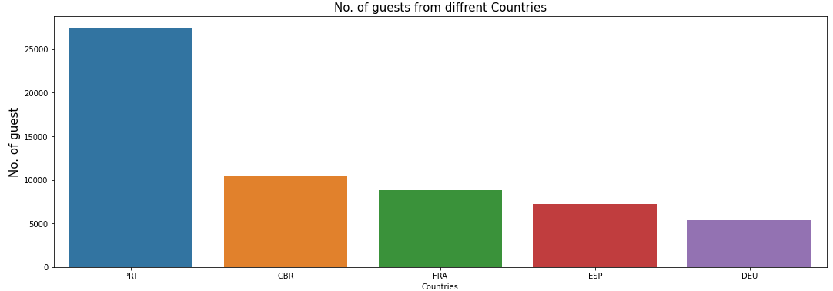
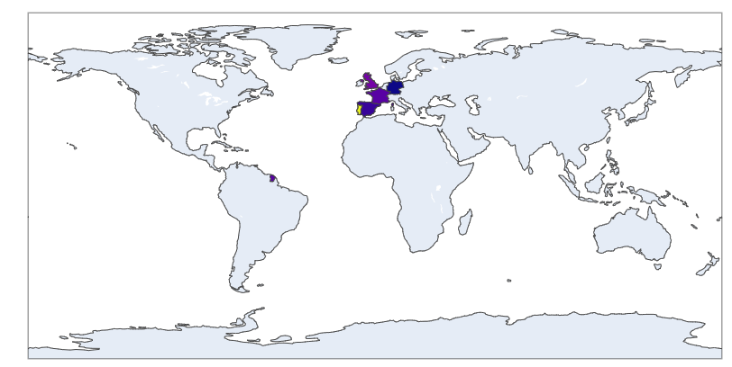

Data Visualization
The maximum number of guests are from which country?
Observation : More than 25000 people, or the majority of the attendees, are from Portugal.
Abbreviations for nations:
PRT- Portugal GBR- United Kingdom FRA- France ESP- Spain DEU - Germany

Slide 26
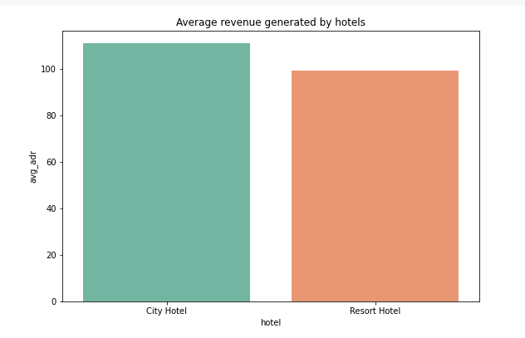

Data Visualization
Which hotel produces maximum revenue?
According to the above graph, the average revenue of city hotels is higher than that of resort hotels Observation

Slide 27
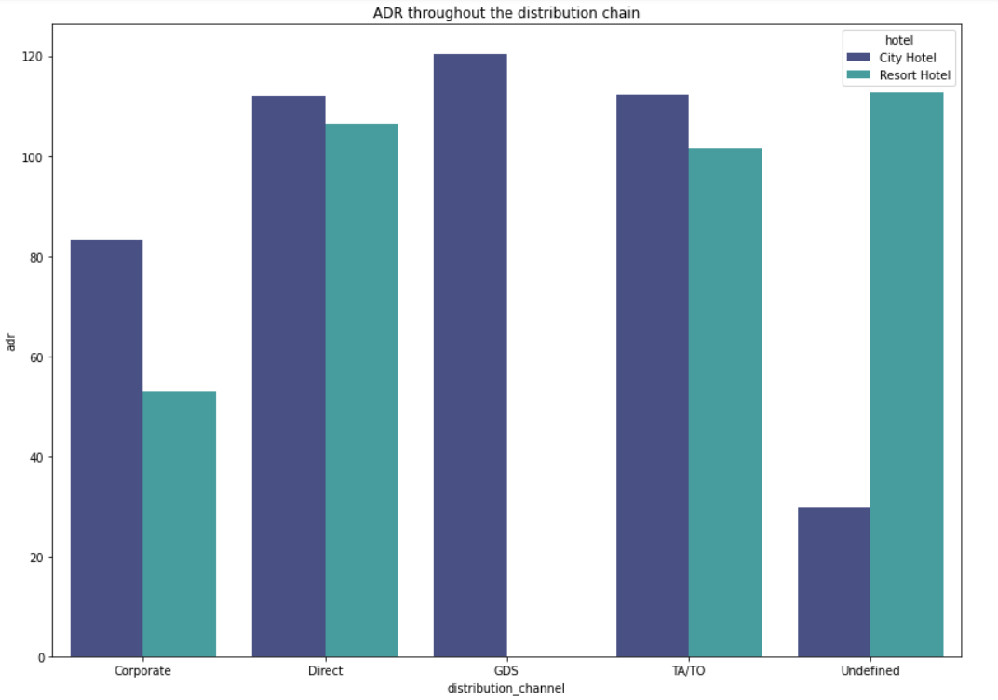
Data Visualization
Which distribution route has given ADR the most boost in terms of revenue?
Corporate - These are companies that help businesses make hotel reservations.
GDS-GDS - serves as a global link between travel agents and suppliers, including hotels and other lodging establishments. It enables automated transactions and provides real-time product, price, and availability data to travel agencies and internet booking engines.
Direct - refers to making reservations with the specific hotels directly.
TA/TO - Bookings are made through travel agents or travel operators.
Undefined – Reservations are not defined. Maybe customers made their reservations when they arrived.
Inference
In both types of hotels, "Direct" and "TA/TO" have contributed to adr about equally.
GDS made a significant contribution to adr of the "City Hotel" type.
GDS contributing little to hotel reservations at resorts.

Slide 28
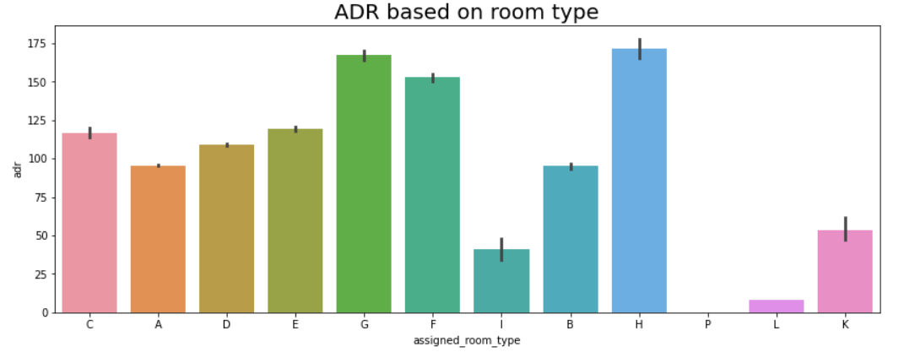
Data Visualization
Which room type has the highest average daily rate?
H type has the highest Average daily rate followed by G type and F type

Slide 29
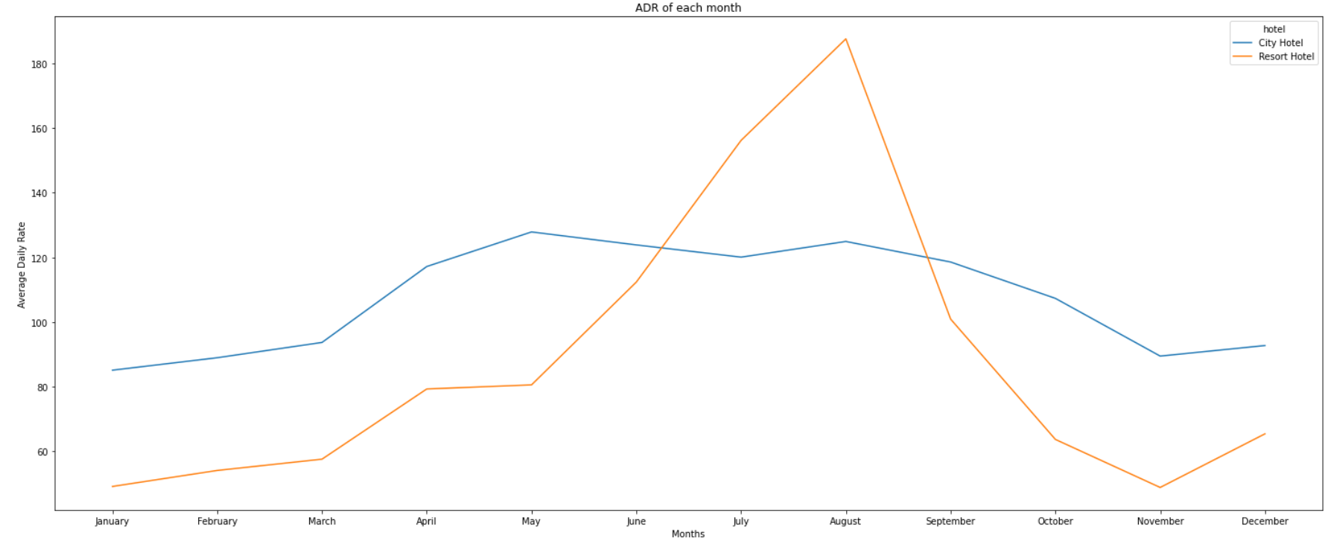
Data Visualization
In which month do the hotels have the highest ADR?
In comparison to City Hotels, the ADR for Resort Hotel is higher in the months of June, July, and August. Perhaps clients/people wish to vacation in resort hotels this summer.
January, February, March, April, October, November, and December are the ideal months for visitors to resort or city hotels because of the low average daily rate throughout these months.

Slide 30
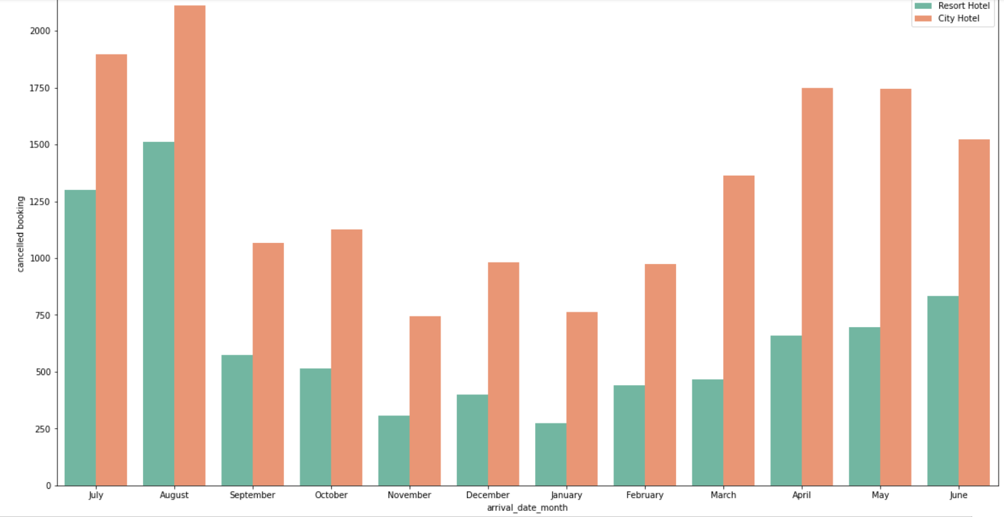
Data Visualization
Which month saw the most canceled reservations?
For hotels in cities, the majority of cancellations occurred in the month of October, but for hotels in resort areas, the majority occurred in the month of August. Additionally, similar cancellations of reservations for both hotel types occurred in the month of August. City hotels had greater cancellations of reservations overall.

Slide 31
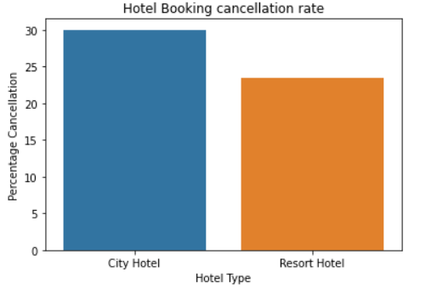
Data Visualization
Which hotel has the highest cancellation rate, the city or the resort?
About 30% of hotel reservations for city hotels and 24% for resort hotels are cancelled.

Slide 32
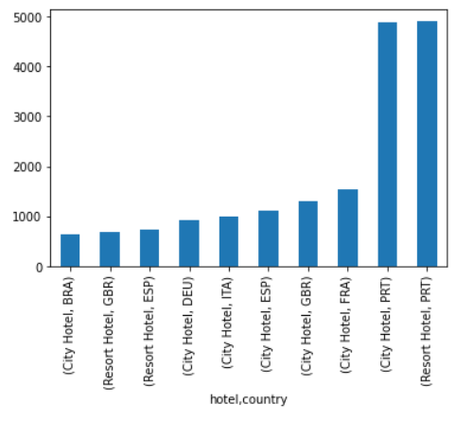
Data Visualization
Determining which countries have the most hotel cancellations in different type of hotels
Here we can say that PRT(Portugal) country made the highest number of cancelation under the city hotel
Here we understand that the PRT country has made the large number of cancelation in resort type hotel.
so after the compare with both bar chart then we get that both hotel got most cancelation by PRT country.

Slide 33
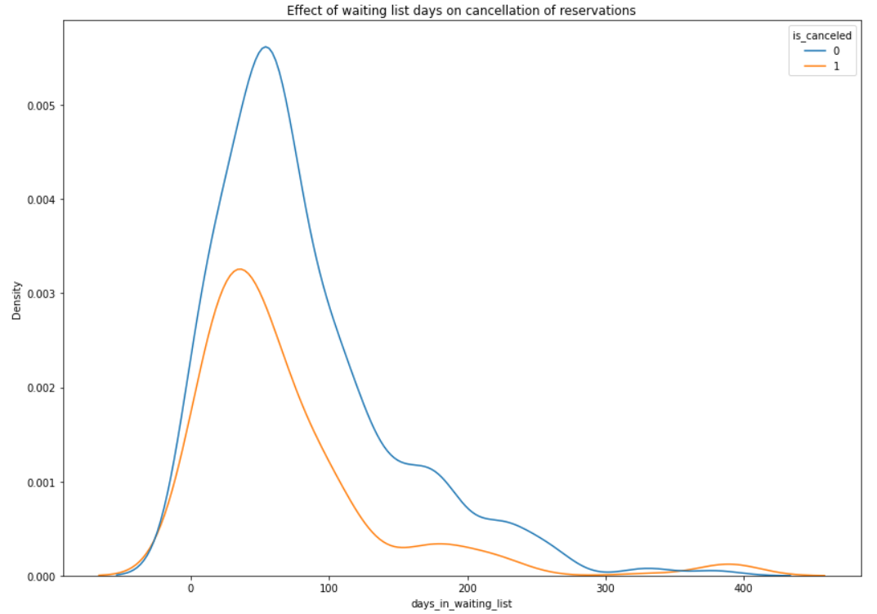


Data Visualization
Does a longer waiting period result in cancelled bookings?
There is no direct correlation between a longer waiting period and booking cancellation, as can be seen from the fact that the majority of reservations that had less than 100 days on the waiting list were cancelled. However, reservations that had more than 100 days on the waiting list were also cancelled at a slightly higher rate.

Slide 34
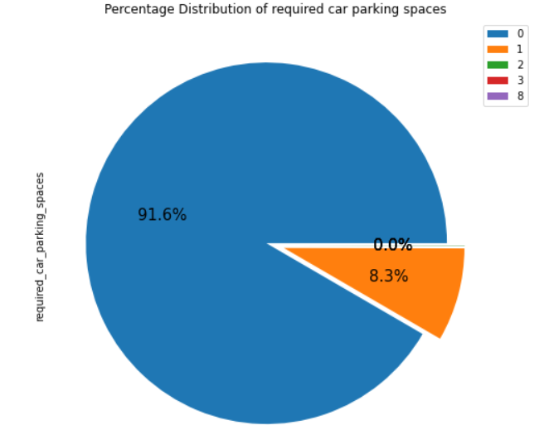
Data Visualization
What is the percentage distribution of required_car_parking_spaces?
Observation:
91.6 % guests does not required the parking space. only 8.3 % guests required parking space.

Slide 35

So lets talk about challenges that we faced
One of the major challenge was to clean the datasets as a lot of scattered information was present especially in the 1st data set.
Handling the error, duplicate and NaN values in the dataset.
To draw meaningful insights, we had to design multiple visualizations like scatterplot, jointplot etc. without compromising the results and trends.
To overcome above challenges, we followed
Alma Better class material
Pandas and NumPy
GeeksforGeeks
Analytics Vidhya
Stack Overflow

Slide 36

Conclusion
City Hotels are most preferred by the customer.
Maximum number of bookings were done in month of august so we can put more offers during this month.
As compared to couples ,single and family with more than 3 members is less expensive.
TA/TO distribution channel is more preferred by the customer as compared to others, In order to grow their business, hotels might partner with these agents and operators or promote using them as a medium.
Most visitors of resort hotel stayed for one day, however most city hotel guests spent anywhere between one and seven days.
the most popular meal type among guests is BB (Bed and Breakfast), followed by HB (Half Board) and SC (Self Catering).From the above graph it is clear that highest rate of returning customers are from the resort hotel
From above it is clear that city hotels are mostly preferred by babies, adults and children
More than 25000 people, or the majority of the attendees, are from Portugal. he average revenue of city hotels is higher than that of resort hotels.

Slide 37
H type has the highest Average daily rate followed by G type
January, February, March, April, October, November, and December are the ideal months for visitors to resort or city hotels because of the low average daily rate throughout these months.
For hotels in cities, the majority of cancellations occurred in the month of October, but for hotels in resort areas, the majority occurred in the month of August.
Additionally, similar cancellations of reservations for both hotel types occurred in the month of August. City hotels had greater cancellations of reservations overall.
For hotels in cities, the majority of cancellations occurred in the month of October, but for hotels in resort areas, the majority occurred in the month of August.
Additionally, similar cancellations of reservations for both hotel types occurred in the month of August. City hotels had greater cancellations of reservations overall.
About 30% of hotel reservations for city hotels and 24% for resort hotels are cancelled.
here we can say that PRT country made the highest number of cancelation under the city hotel
here we understand that the PRT country has made the large number of cancelation in resort type hotel.
There is no direct correlation between a longer waiting period and booking cancellation, as can be seen from the fact that the majority of reservations that had less
than 100 days on the waiting list were cancelled. However, reservations that had more than 100 days on the waiting list were also cancelled at a slightly higher rate.
91.6 % guests does not required the parking space. only 8.3 % guests required parking space.
As a result, the most popular meal type among guests is BB (Bed and Breakfast), followed by HB (Half Board) and SC (Self Catering).

Slide 38


